Slide 1

ETL PROJECT
FLIGHT DATA-2008

Slide 2
BASIC UNDERSTANDING WITH ETL:
Extraction, in which raw data is pulled from a source or multiple sources.
Transformation, in which data is updated to match the needs of an organization and the requirements of its data storage solution.
Loading, in which data is delivered and secured for sharing, making business-ready data available to other users and departments, both within the organization and externally.

Slide 3
Objective:
The objective for this project is to process flight details data from csv files into a Data Warehouse. Create an ETL pipeline in python and SQL to load the final tables. Also perform basic analysis on the final tables.

Slide 4
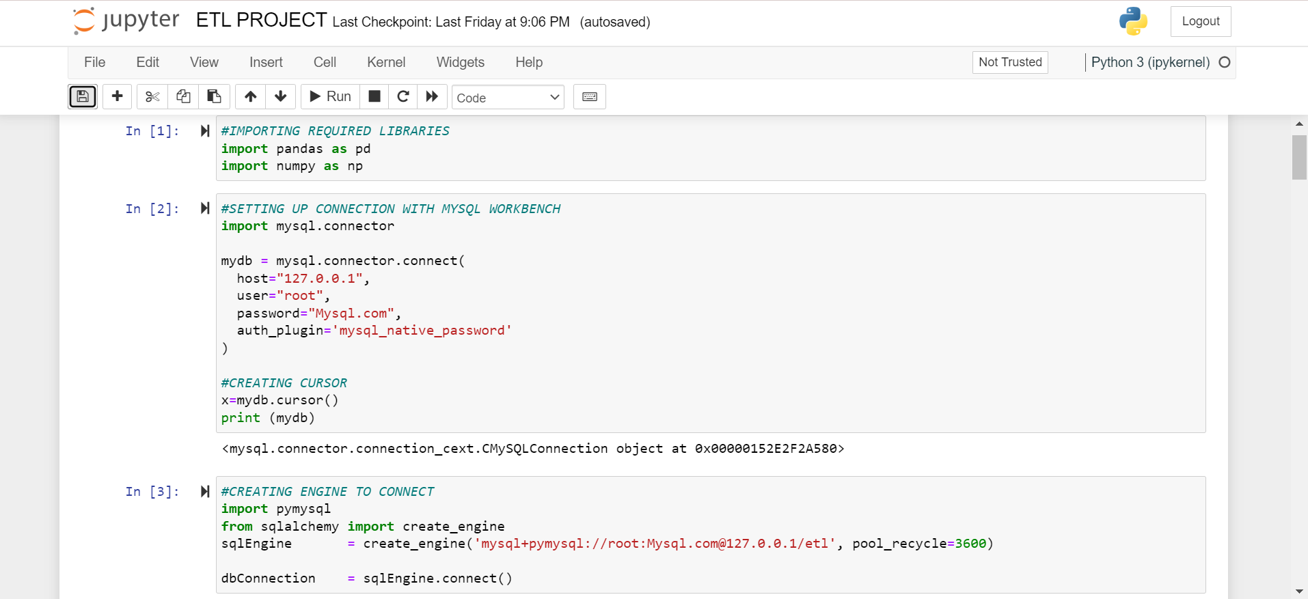

Slide 5
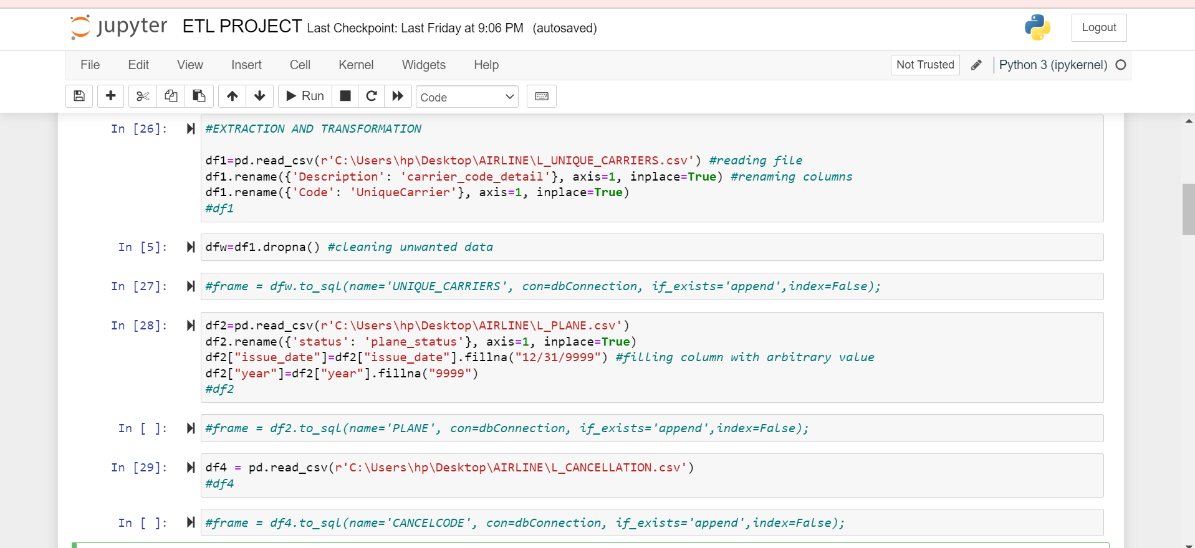

Slide 6
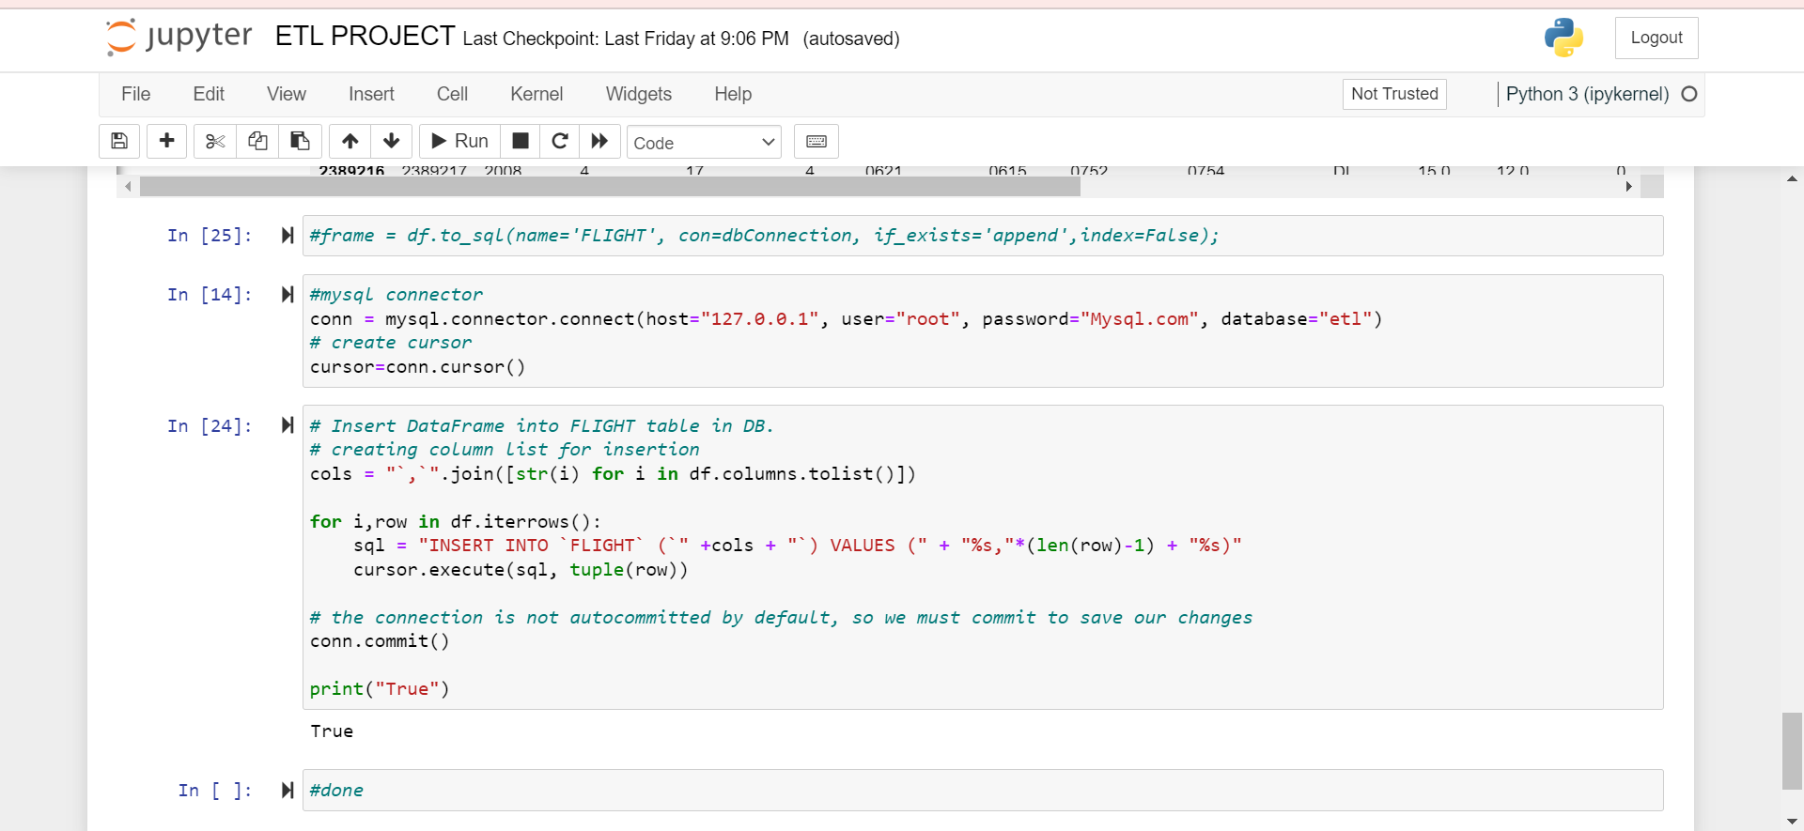

Slide 7
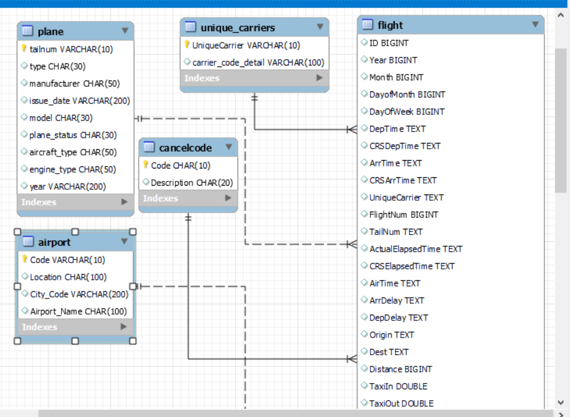
ER Diagram of Airlines Data

Slide 8
Analysis:
1. Find the total flights by airline.
2. Find the number of total flights cancelled for each airline for which cancellation reason was not in weather or security related.
3. Check out the average delay on airline to see what airlines have the longest delays.
4. Can you see a trend in the delays by month and day of week?

Slide 9

1.Find the total flights by airline.
SELECT F.UniqueCarrier, U.carrier_code_detail AS airlines_name,COUNT(F.UniqueCarrier) total_flights
FROM FLIGHT F LEFT join UNIQUE_CARRIERS U
ON F.UniqueCarrier = U.UniqueCarrier
GROUP BY F.UniqueCarrier
order by COUNT(F.UniqueCarrier) DESC;

Slide 10
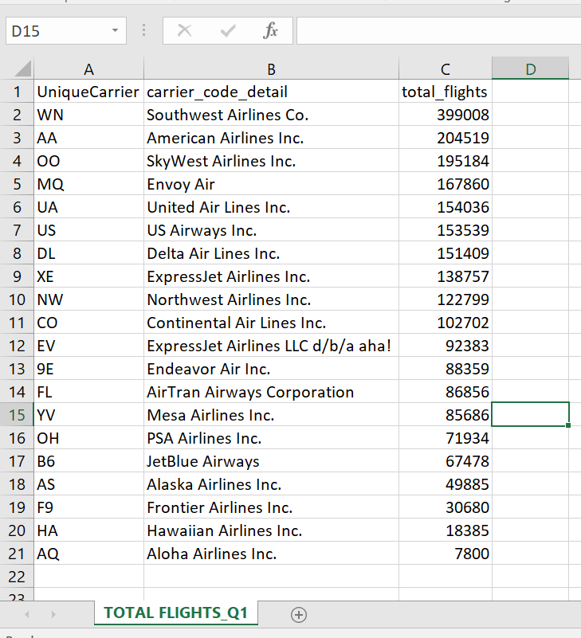

Slide 11
Find the number of total flights cancelled for each airline for which cancellation reason was not in weather or security related.
SELECT UniqueCarrier as airlines_names,Description as cancellation_reason,CancellationCode,COUNT(UniqueCarrier) as flight_total
FROM FLIGHT F LEFT join cancelcode c
ON F.CancellationCode = c.Code
where F.CancellationCode NOT IN ('B','D','0')
group by UniqueCarrier,Description,CancellationCode
ORDER BY CancellationCode;

Slide 12
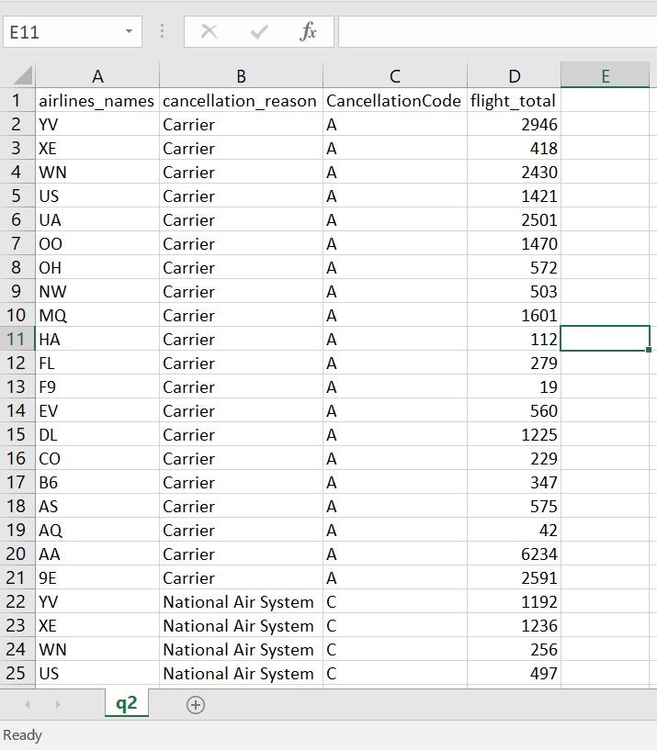

Slide 13
Check out the average delay on airline to see what airlines have the longest delays.
SELECT F.UniqueCarrier, U.carrier_code_detail AS airlines_name,ROUND (AVG(ArrDelay),2) AS avg_arrival_delay,round (avg(DepDelay),2) as avg_departure_delay
FROM FLIGHT F LEFT join UNIQUE_CARRIERS U
ON F.UniqueCarrier = U.UniqueCarrier
GROUP BY UniqueCarrier, U.carrier_code_detail
ORDER BY AVG(ArrDelay) desc;

Slide 14
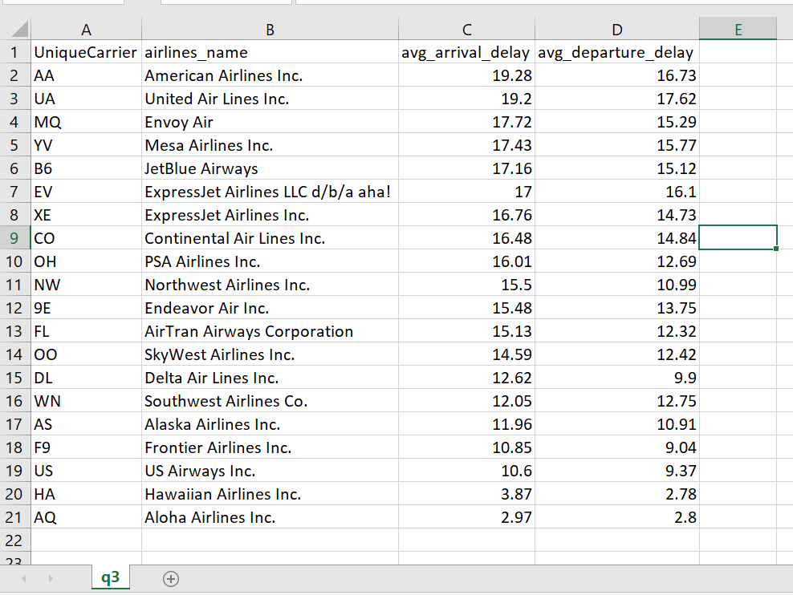

Slide 15
Can you see a trend in the delays by month and day of week?
SELECT F.Dayofweek ,ROUND (AVG(ArrDelay),2) AS avg_arrival_delay,round (avg(DepDelay),2) as avg_departure_delay
FROM FLIGHT F
GROUP BY F.Dayofweek
ORDER BY F.Dayofweek;
SELECT F.Month ,ROUND (AVG(ArrDelay),2) AS avg_arrival_delay,round (avg(DepDelay),2) as avg_departure_delay
FROM FLIGHT F
GROUP BY F.Month
ORDER BY F.Month;

Slide 16
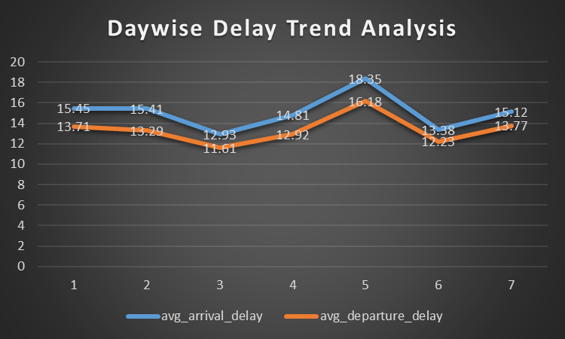
Graphical Representation of Daywise Delay Trend

Slide 17
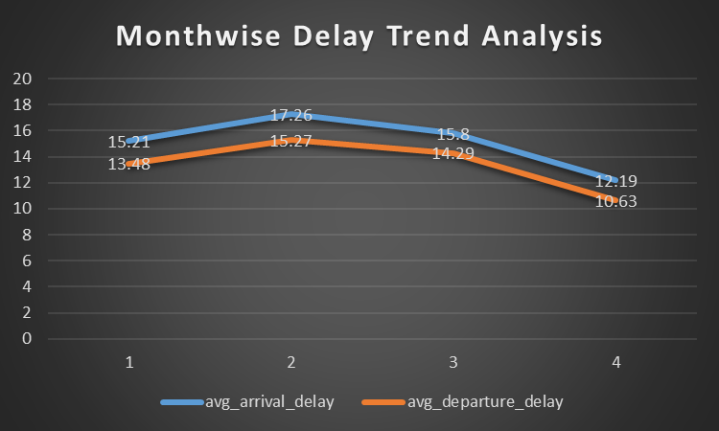
Graphical Representation of Daywise Delay Trend

Slide 18

Any Questions

